Slide 1
Introduction to AWT

Slide 2

Objectives of This Session
Identify the need for AWT
State the hierarchy of classes in AWT
Demonstrate the first AWT class (using Graphics class).
Identify the Component & Container classes
Demonstrate an AWT class with components.
Explain the functioning of AWT with Peer Classes
Explain callback mechanism

Slide 3

Identify the need for AWT
To visually enhance applets & applications.
  I.e. Java programmer should be able to write programs that move & size windows, put components, display text & colors, fonts etc
Notes:
Till now we saw only how to write applications that may take user I/p’s , display results on the System console.
But modern programs & web pages do not work like this.
By providing different applications with a consistent set of intuitive user interface components, GUI’s allow user to spend less time in trying to remember which key stroke sequences do what & spend more time using the program in a productive manner.
Need for Java prg to have more GUI.java had to find a way to write applications that would be GUI & platform independent.
While trying to provide a common solution, developers had to consider so many drawbacks:
Eg : Mac can have only one button mouse.
It does not have picture buttons like windows95.

Slide 4
The AWT library
AWT is a general-purpose, multi-platform windowing library.
It’s a standard part of Java environment.
Provides all the basic functionality that may be needed for use in developing GUI application.
Provides classes that encapsulate many useful GUI components.

Slide 5
AWT class
import java.awt.*;
class MyFrame extends Frame
{
public void paint(Graphics g){
g.drawString(“Hello world”);
}
public static void main(String args[])
{
Frame f = new MyFrame();
f.setSize(100,100);
f.show();
}
}
Notes:
The Frame class:
The Window class is derived from Container class. Although it is not an abstract class, you rarely create Window objects. But it is the root class for 2 very useful classes: Frame & Dialog.
Window & its derived classes allow you to create windows that can float over & even outside the browser window.
Frame is derived from Container class, Thus, it can contain other controls, Images & text.
When a frame is created, it is by default invisible. & its size is 1X1 pixels.
The paint() method:
Seldom called directly by the programmer because drawing graphics is an event-driven process.
It is called automatically when window has to be repainted.
It works like WM_Paint of windowing software. The OS sends a message to the windowing system, whenever a event like above occurs.

Slide 6
The Color class
Defines methods & constants for manipulating colors in a Java program.
Every color is created from a red, green & blue component.
To change color, you must create a Color object or use one of the predefined Color constants.

Slide 7
The Font class
Allows to create a font object that will display text in a particular font.
The number of fonts varies greatly across systems.
Java uses standardized font names & maps these into system-specific font names for portability.

Slide 8
The Color & Font class
public void paint(Graphics g)
{
g.setColor(Color.blue);
Font f = new Font(“TimesRoman”,Font.BOLD,20);
g.setFont(f);
g.drawString(“Hello World”, 50,50);
}
Notes:
// or
Color c = new Color(100,100,100);
g.setColor( c );

Slide 9
Graphics Class
Graphics is an abstract class.
A graphics context enables drawing on screen in Java.
A Graphics object encapsulates state info needed for the basic rendering options that java supports.
It remembers a collection of settings for drawing images & text.
All drawing in Java must go thru a Graphics object.
Notes:
Graphics is an abstract class for all graphics contexts that allow an application to draw onto components that are realized on various devices as well as onto off-screen images
The state info includes -
component object
current clip
current color
current font
current logical pixel option function(XOR/Paint)

Slide 10
Graphics Class
Why is Graphics class an abstract class ?
  Reason is : Java’s Portability
  Graphics capabilities that enable a PC running windows are different from ones that enable a UNIX workstation to draw a rectangle.
  When Java is implemented on each platform, a derived class of Graphics is created that actually implements the drawing capabilities.
  Eg. WGraphics class for Windows

Slide 11
AWT(Components)
Button
Checkbox
Choice
Menu
TextField
Scrollbar
Canvas
CheckboxGroup
List
Label
TextArea
ScrollPane

Slide 12
Component hierarchy in AWT
Object
Component
Scrollbar
Canvas
Checkbox
Choice
Label
Text Component
Text Area
List
Text Field
Container

Slide 13
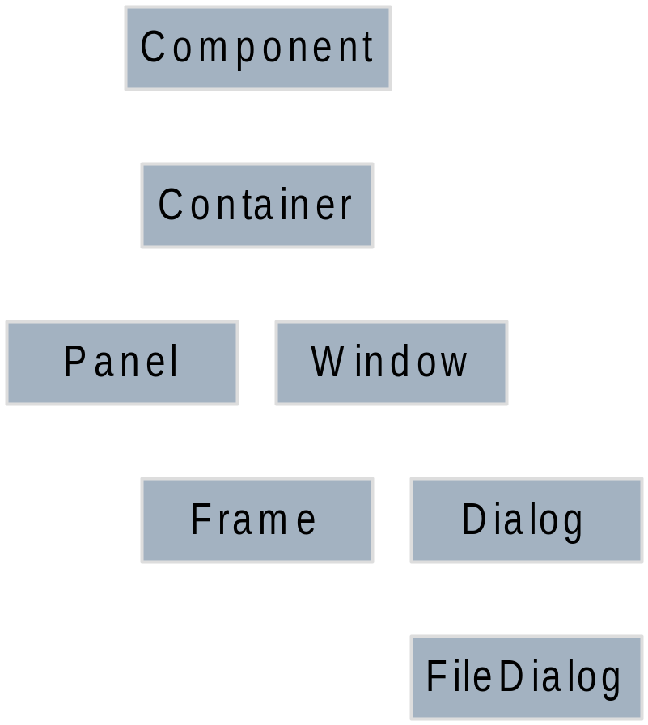
AWT (Container)

Slide 14
AWT(Geometry)
Several classes in AWT package provide handy encapsulation of int values related to screen geometry.
  Dimension
  Insets
  Point
  Polygon
  Rectangle

Slide 15
Java Class using components
import java.awt.*;
class MyFrame extends Frame
{
TextField t1;
Button b1;
MyFrame() {
t1 = new TextField(20);
b1 = new Button(“Click”);
add(t1); add(b1);
}

Slide 16
Java Class using components
public static void main(String args[])
{
Frame f = new MyFrame();
f.setSize(100,100);
f.show();
}

Slide 17
AWT(Toolkit)
Toolkit class: encapsulates details of the underlying OS & h/w that a JVM is running on.
This object is created when the JVM starts, before any of the application classes are loaded.
Toolkit defines the methods that create OS peers for AWT components
These methods are called automatically as the components are created & thus shouldn't be called by the programmer.
You can get a Toolkit object with the getDefaultToolkit() method of Toolkit class.

Slide 18
The callback mechanism
Callback is an important concept for Event driven programming.
Callback means that the programmer should give the implementation of a method.
The programmer does not call the method but there is an arrangement such that some callback program invokes the method when required.

Slide 19
Peers
How does the basic AWT library deal with user interface elements?
  By delegating their creation & behavior to the native GUI toolkit on each target platform.
  The resulting program will then run on any platform with the “look & feel” of the target platform.

Slide 20
Swing components hierarchy
java.lang.Object
|
java.awt.Component
|
java.awt.Container
|
javax.swing.JComponent
|
Swing Components

Slide 21
Swing
The AWT library took help of underlying OS to generate peers for each UI component.
Swing components are purely written in Java.
Therefore lightweight, since no peers are created.
Also they need not take on the “look & feel” of the target platform ; thus helps in maintaining a consistent “look & feel” over all platforms.

Slide 22
Swing Program
public class SwingFrame extends JFrame implements ActionListener {
JButton b1, b2;
JTextField tf;
public SwingFrame(){
tf=new JTextField();
b1=new JButton(“Click”);
b2=new JButton (“Cancel”);

Slide 23
Swing Program
b1.addActionListener(this);
b2.addActionListener(this);
Container cp=getContentPane();
cp.add(b1);
cp.add(b2);
cp.add(tf);
}
public static void main(String str[]){
Jframe f=new SwingFrame();
f.setSize(800,800);
f.setVisible(true);
}
}

